Slide 1
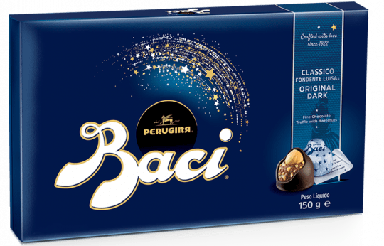
BACI Designs: BEFORE-AFTER-CONTROL-IMPACT!!!
Dr John Dwyer CONS7008

Slide 2
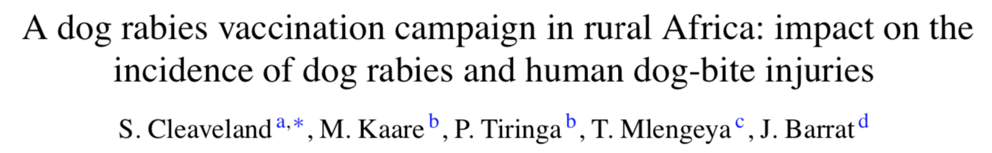
Dog rabies vaccination
In the Serengeti (Africa):
1996-2001, four dog vaccination campaigns conducted in villages
Vaccination coverage of the dog population estimated as 60-74%

Slide 3
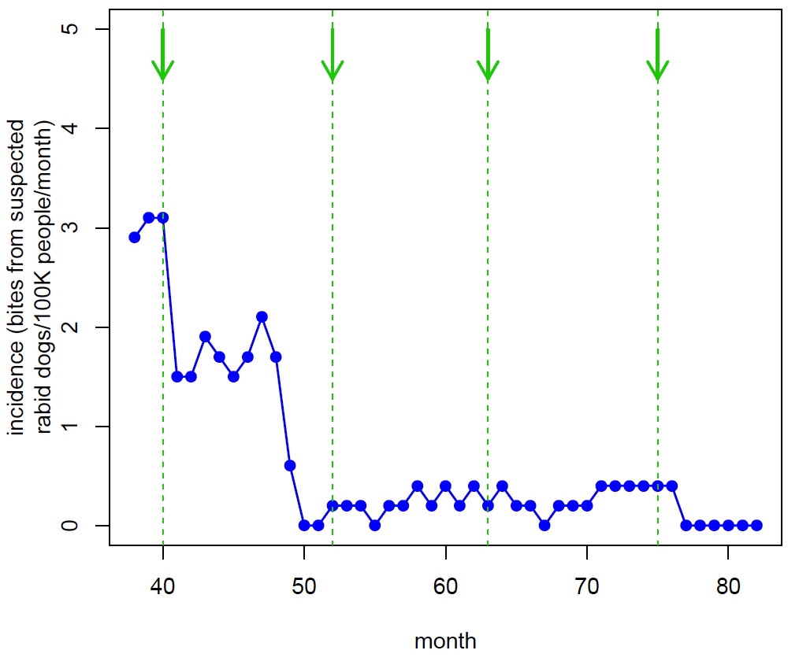
Dog rabies vaccination
Cleaveland et al. 2003 Vaccine

Slide 4
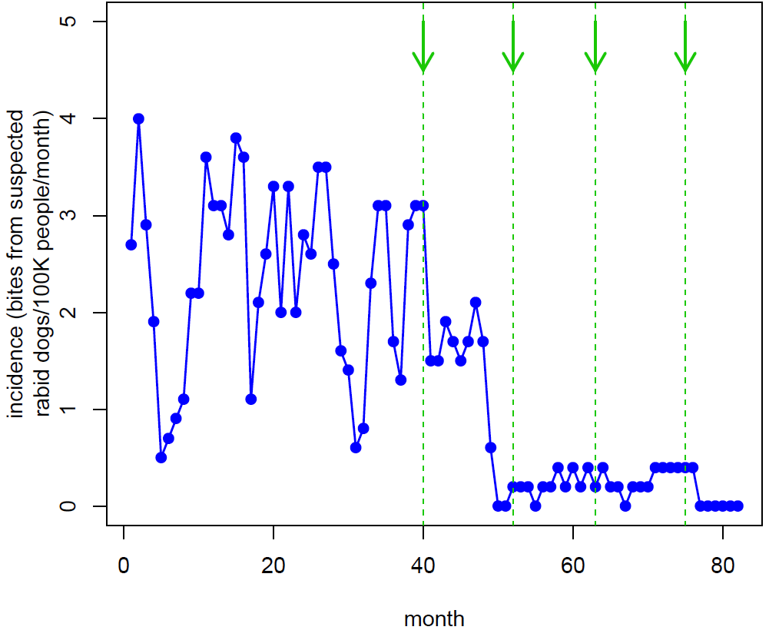
Dog rabies vaccination
Cleaveland et al. 2003 Vaccine

Slide 5
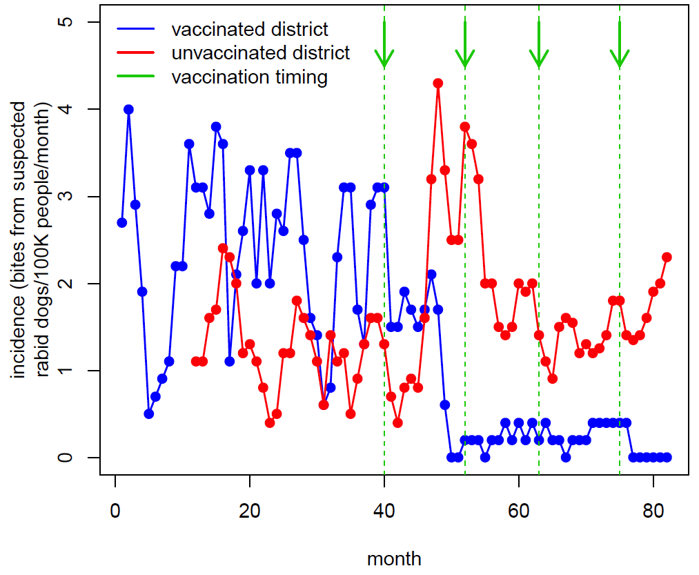
Dog rabies vaccination
Cleaveland et al. 2003 Vaccine

Slide 6
Before-After-Control-Impact (BACI)
Widely used to quantify environmental impacts
Premise:
treatment will result in a different pattern of change at the impact site compared to the control site
measure response before and after at control and impact sites to evaluate effect of treatment

Slide 7
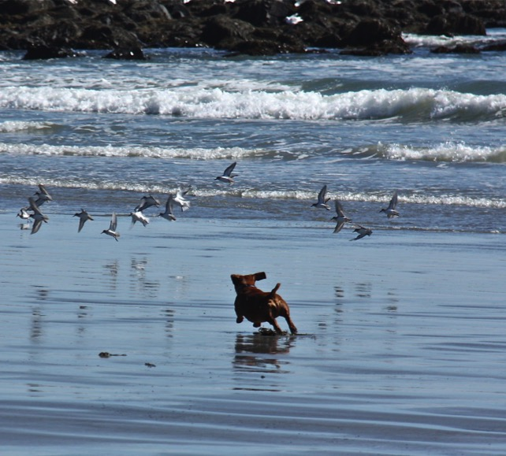
Are signs effective at reducing shorebird disturbance?

Slide 8
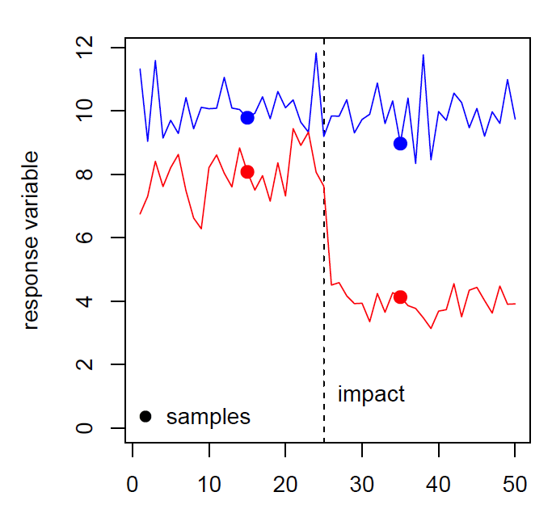
Simple BACI
One sample before, one sample after
Disturbance (flights/hr)
sign installed
samples
time

Slide 9
Simple BACI
Problems with simple design?
variation in response variable(s) not quantified (either in time or space)
May not detect impact when it is present (e.g., lag effect)
Or may even detect impact in the wrong direction!!!

Slide 10
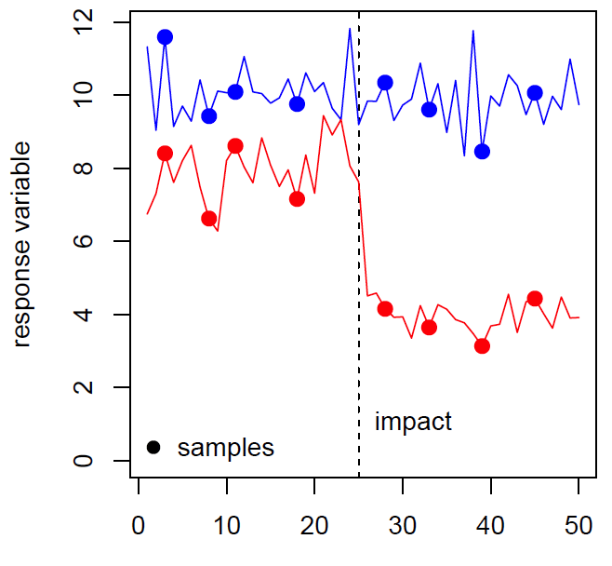
Repeated measures BACI
samples taken at multiple intervals before and after treatment
Disturbance (flights/hr)
sign installed
samples
time

Slide 11
Repeated measures BACI
Improves estimate of mean, provides estimate of variance before / after treatment
enables detection of lag effects and differentiation between short-term and prolonged impacts

Slide 12
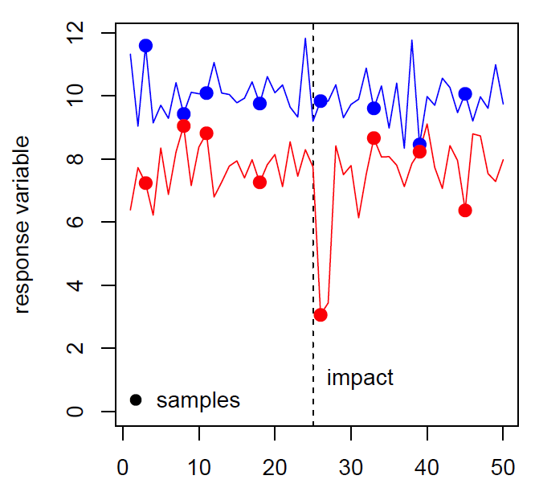
Repeated measures BACI
What if this was the actual response?
Disturbance (flights/hr)
sign installed
samples
time

Slide 13
Repeated measures BACI
Any problems?
Disturbance (flights/hr)
sign installed
samples
time

Slide 14
Repeated measures BACI
Any problems?
The control (blue) might be different to the impact (red) for lots of reasons!!!
Suggestions?
Disturbance (flights/hr)
sign installed
samples
time

Slide 15
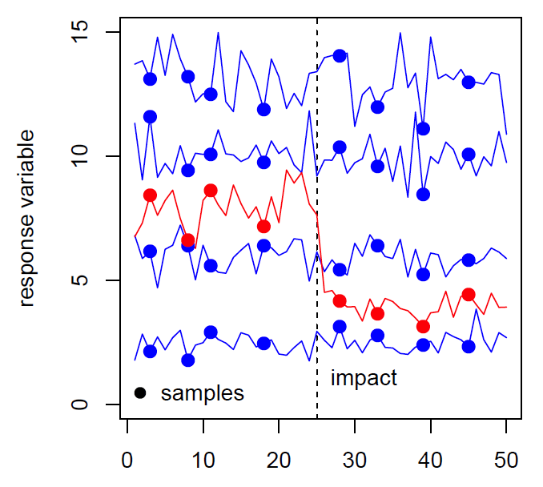
Repeated measures BACI + multiple controls
Include multiple controls!!!
Captures variation among potential control sites
Still lacks replication of impact sites
Disturbance (flights/hr)
sign installed
samples
time

Slide 16
BACI Experiments
Ideal where management intervention needs to be tested
Opportunities to implement “gold-plated” BACI designs
MULTIPLE CONTROLS AND MULTIPLE IMPACTS!!!

Slide 17
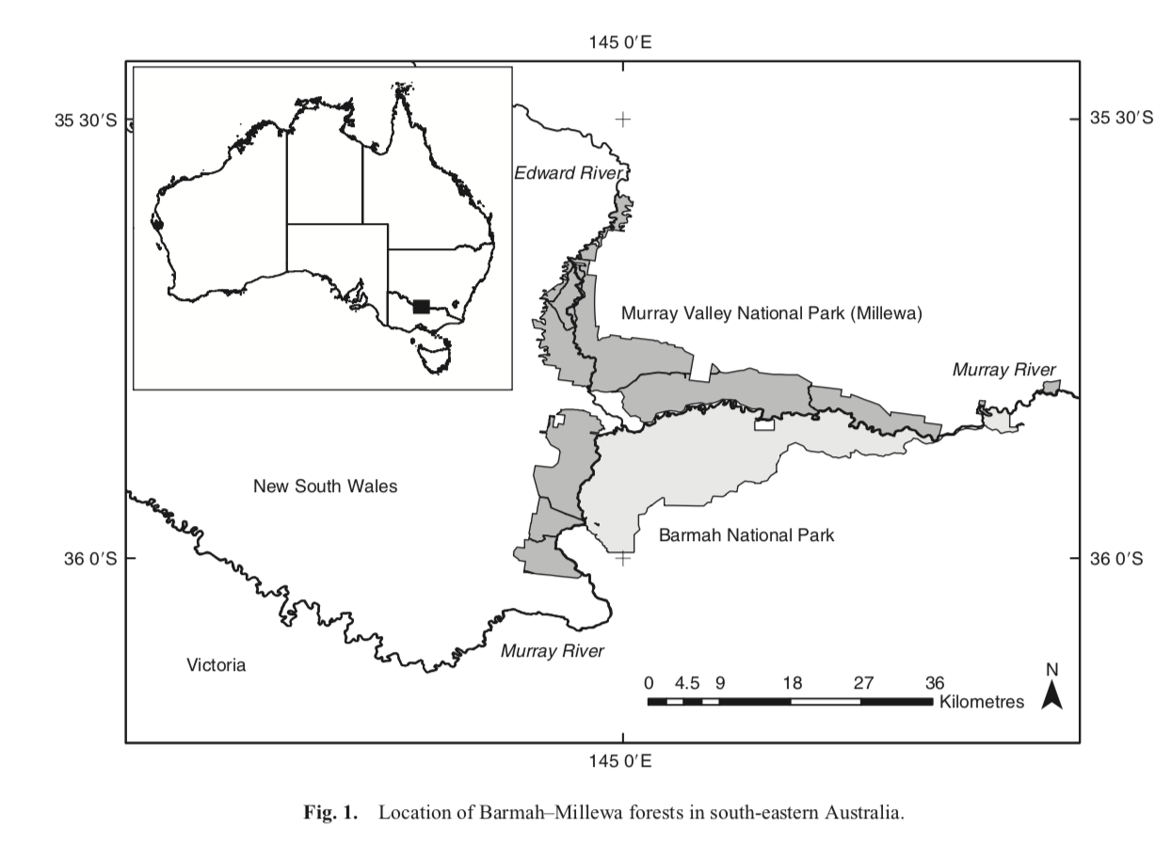

Slide 18
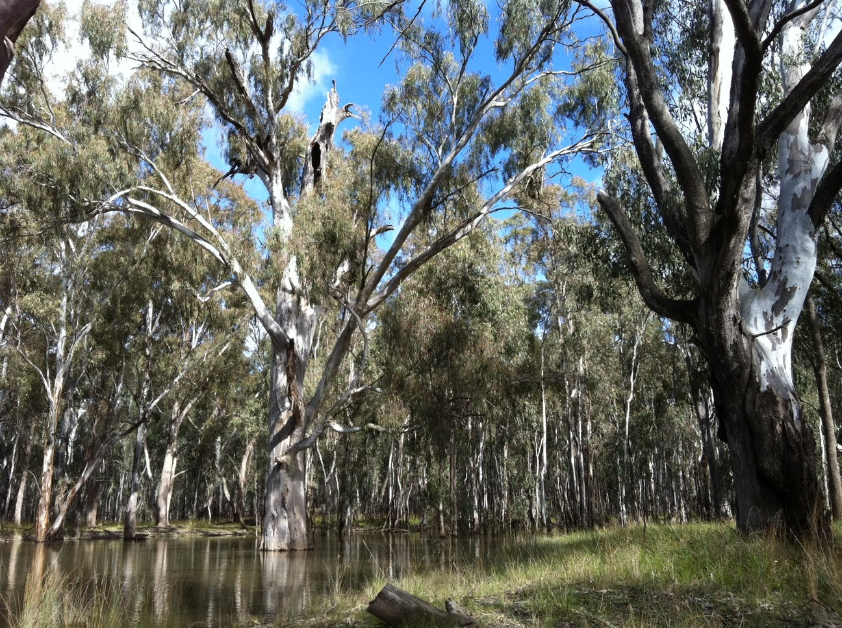
Photo: Emma Gorrod

Slide 19
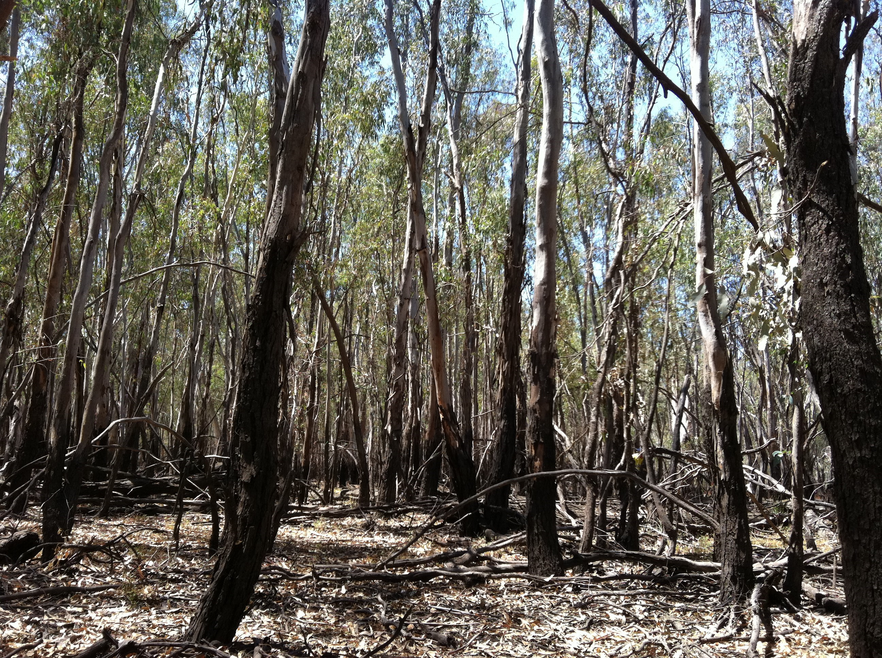
Photo: NSW DPIE

Slide 20
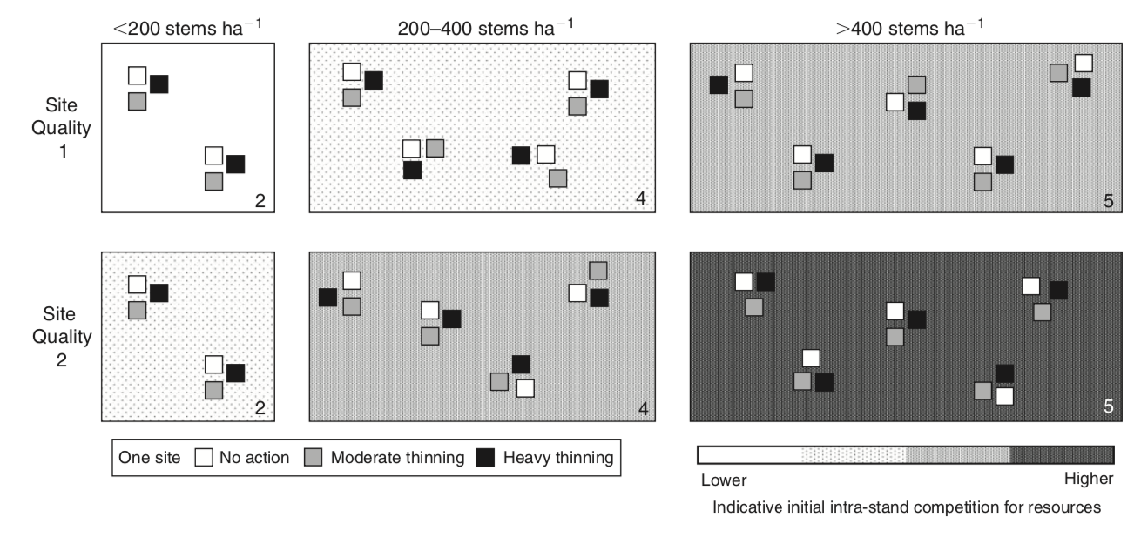
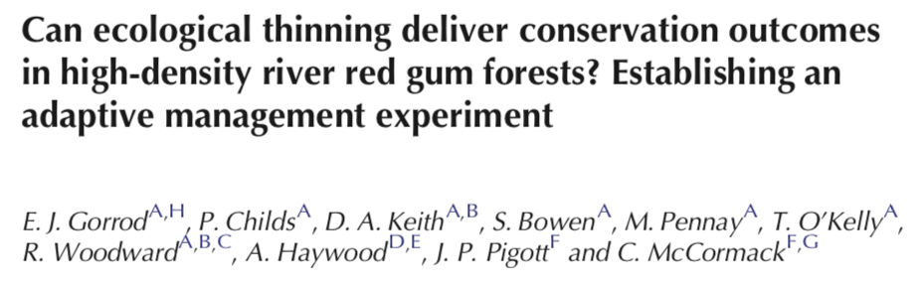

Slide 21
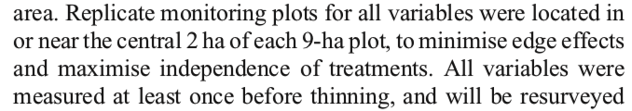
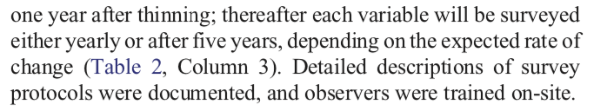

Slide 22
Key points
Simple BACI is not guaranteed to detect impacts!
Repeated measures BACI is better
Add multiple control sites to improve further
If you can, have multiple control sites AND multiple impact sites

Slide 23
https://www.youtube.com/watch?time_continue=173&v=9pJlMqCFHj8

Slide 24
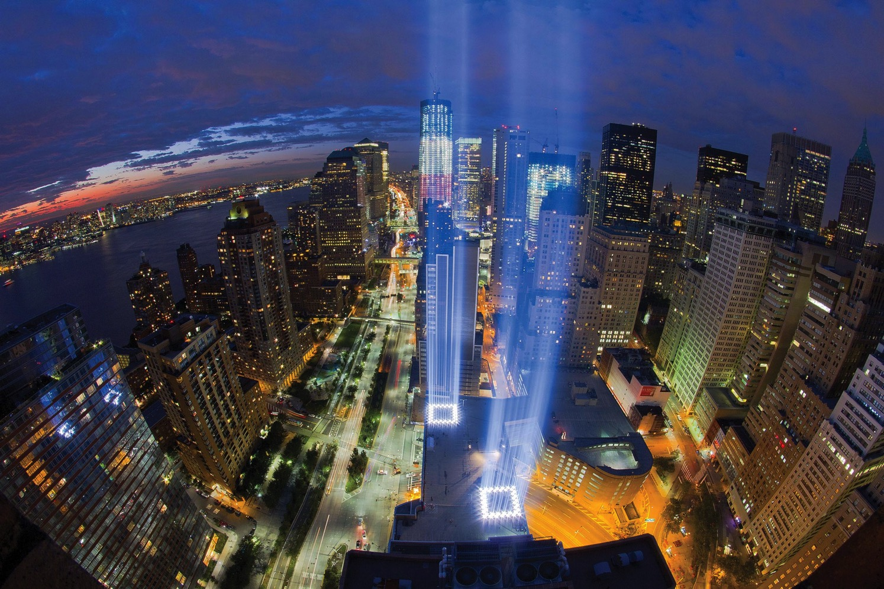
Tribute In Light

Slide 25
Sampling design:
baseline (control) = surrounding 2-20 km
multiple “impacts” (repeated lights on / off)
7 nights over 7 years! (2008-2016)

Slide 26
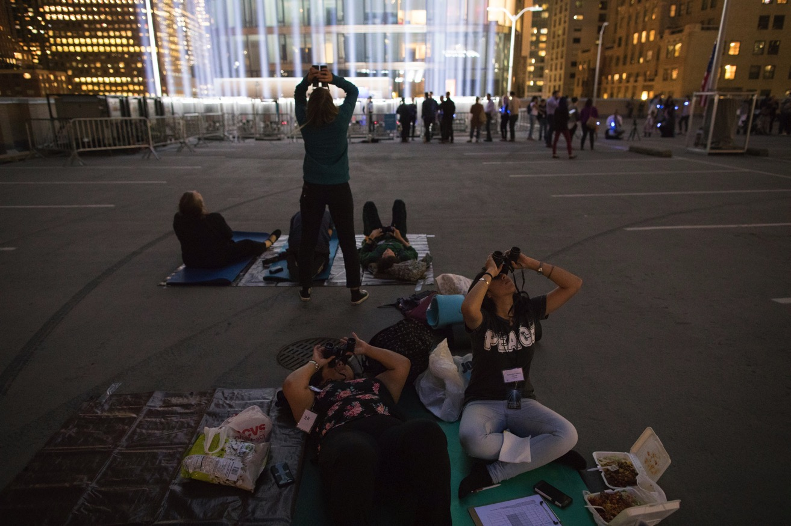
Method 1: Visual observations
Van Doren et al. 2017 PNAS

Slide 27
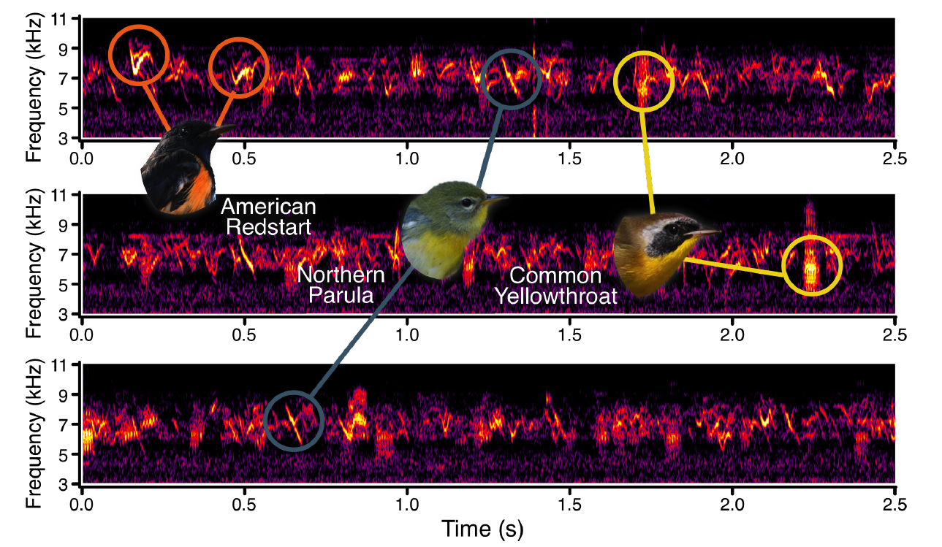
Method 2: Acoustics
Van Doren et al. 2017 PNAS

Slide 28
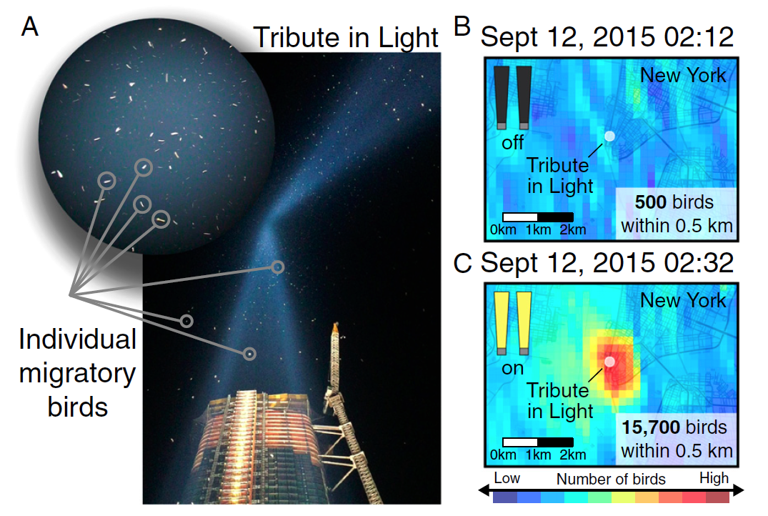
Method 3: Radar
Van Doren et al. 2017 PNAS

Slide 29
Birds love a tribute!!!
~1.1 million birds influenced by Tribute in Light during study period of 7 nights over 7 years (2008-2016)
bird densities near the installation exceeded magnitudes 20x higher than surrounding baseline densities each year

Slide 30
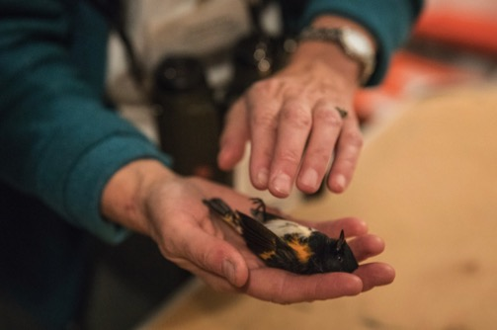
Management response???
Cooperative effort with city, museum, and NYC Audubon Society
Trained volunteers with binoculars monitor aggregations of birds in the light beams
If densities exceed more than 1,000 birds or if a bird is found dead, the lights are shut down for ≈ 20 min to allow the birds to disperse

Slide 31
Coming up
Thursday 1pm Workshop: Rmarkdown assignment introduction
Thursday 5pm Lecture (Rich Fuller): Making do with poor data: Learning while doing
Pre-recorded stats lecture: Generalised linear models
Friday R Prac: Generalised linear models

